Slide 1
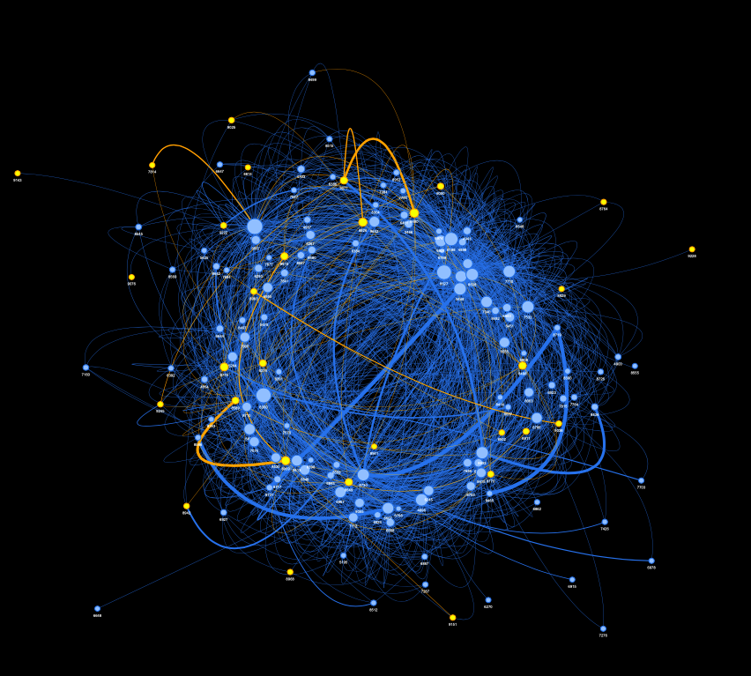
Sparrow Time Series Data Analysis
06/05/2022
Sara Capdevila Solé, CID: 01727810
Fig. 1: “Spaghetti Monster” [1]: Network of birds given certain 'interaction' criteria. Visualisation created using Pyvis [2].
Project partner: Dariusz Duszynski

Slide 2
Contents page
06/05/2022
Introduction
Data Overview
Making and analysing a network
Correlations and Jaccard Similarity
Power laws
Sparisifcation methods
Simulated Networks
Dominance
Conclusions

Slide 3
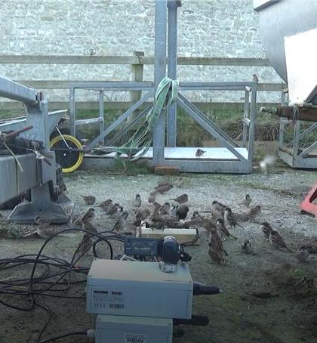
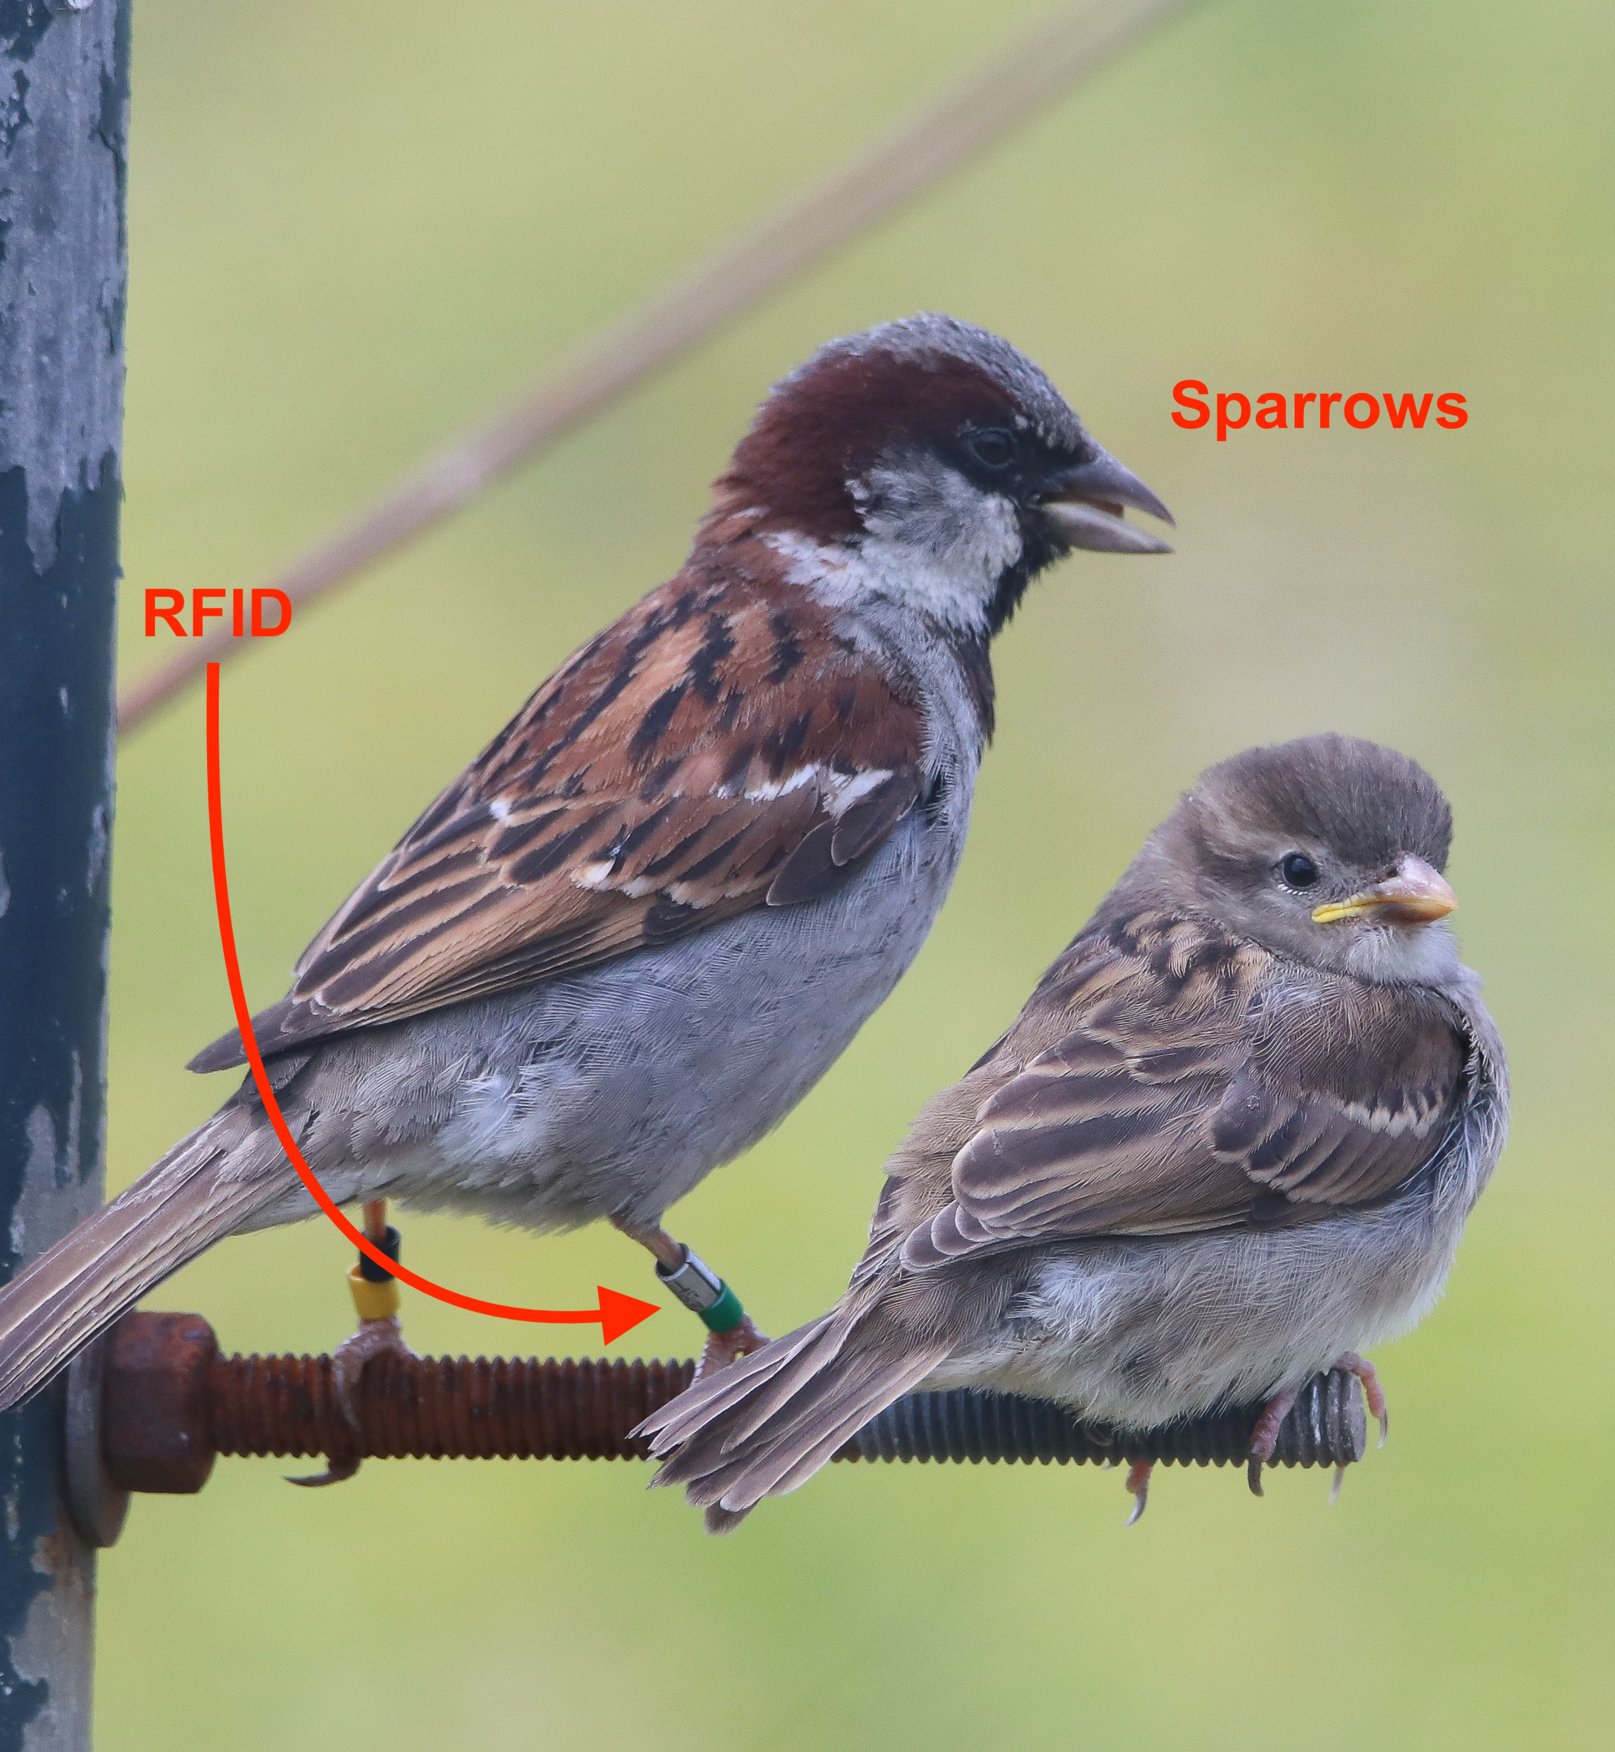
Introduction
06/05/2022
Lundy Island
Sparrows
Fig. 2: Populated sparrow feeder and the RFID detection hardware.
Fig. 3: Sparrows with an RFID tag attached to their leg.
Notes:
Sparrows are small brown birds, very predominant in most of the European territory. They are known to be social animals. Understanding sparrow behavior can give scientistist insight into population changes occur seasonally when factors such as competition, predation, diseases and agricultural practices are controlled.
Lundy Island is a small island off the North Devon coast of the UK. A project of interest is the investigation of the behaviour of a population of sparrows.
This study is focused on recordings of these RFID chips at a Sparrow feeder on this island. These can establish connections between birds, as members who stay in close spatial proximity or who synchronize activities such as foraging can be considered to be in the same social grouping.

Slide 4
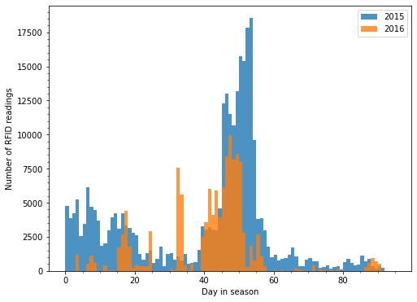
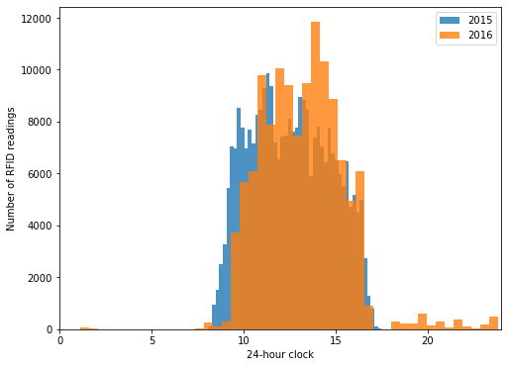
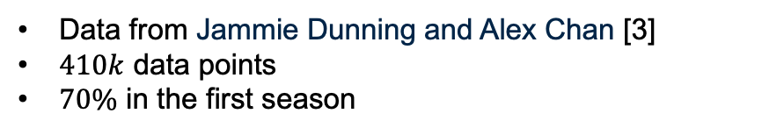
Data Overview
06/05/2022
Data from Jammie Dunning and Alex Chan [3]
$410k$ data points
$70\%$ in the first season
a)
b)
Fig. 4: Sparrow data distribution during both seasons:
RFID readings recorded from day 0 to 92 (season 1) and 0 to 88 (season 2).
Cummulative RFID readings during a day.
Notes:
Two seasons, winter of 2015 and winter of 2016
“””” read slide”””
The blue plot represents 2015 (season 1) and orange is 2016 (season 2).

Slide 5
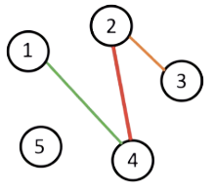
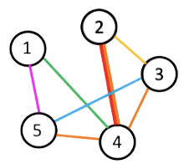
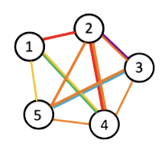
The making of a network
06/05/2022
·Nodes $→$ Sparrows
·Edges $→$ Social connections (from synchronous activities [4][5])
Definition 1: Alpha (α) is the minimum time of absence of a sparrow for the next time it appears at the feeder (a new RFID reading) to be considered a new landing.
Definition 2: Beta (β) is the maximum landing time separation between two different sparrows to be considered a connection/edge in our network.
Change in Network structure as we increase β
Notes:
In its simplest form, a network is a collection of points, or nodes (vertices), joined with lines, or edges [13]. In our analysis, each node represents a bird. An edge is a social connection between two birds.
To create these networks we must first parametrize and clean up the data.
We first do this by introducing alpha:
This is done to remove artefacts of data, such as juping behvaiour of birds and to create a continuous presence in the feeder, when the RFID hardware might not be detecting it.
Variation in the number of landing times with alpha is seen in this plots.

Slide 6
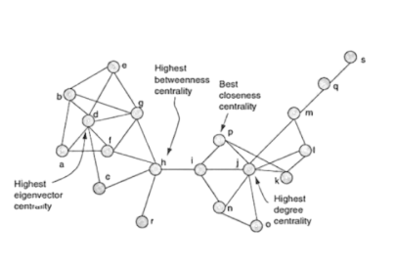

Network analysis
06/05/2022
Network measures:
·Average shortest path
·Eccentricity
·Community detection (greedy modularity maximization) [6]
Centrality measures:
·Degree
·Betweenness (proportion of geodesics)
·Closeness (average of geodesic distance)
·Eigenvector (importance of geodesic)
Betweenness
Closeness
Eigenvector
Degree
Fig. 7: Centrality measures comparison. Modified from [7].
Notes:
Networkx
The Shortest Path length is a measure of the fastest way some information can reach another extreme
Eccentricity is a measure of maxium distance connection one node to all the rest
Community detection is a measure that maximises - The modularity is, up to a multiplicative constant, the number of edges falling within groups minus the expected number in an equivalent network with edges placed at random . Greedy modularity maximization begins with each node in its separate community and joins the pair of communities that most increases modularity until no such pairs exist (dense connections between eachother in the network not manyI
CENTRALITY:
Betweenness is the proportion of geodisics a node lies in
Closeness centrality indicates how close a node is to all other nodes:
It is calculated as the average path length (or geodesic distance) from the node to every other reachable node in the Network .
Eigenvector centrality is a more sophisticated view of cen- trality, unlike the others, it assumes that having more contacts is not the main criterion of importance, but instead, it ranks nodes more highly if they have more important contacts. Under this assumption, the centrality of a node is related to the sum of the centrality of its neighbours (connections)
Betweenness centrality quantifies - how in-between the node is when information is spread through the Network.
Ratio number of geodisics between the two nodes that includes node we are calculating this measure for. Summed over all pairs of nodes.

Slide 7
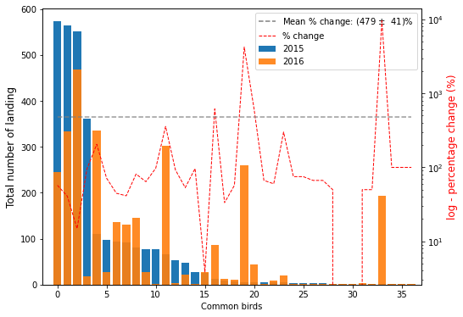
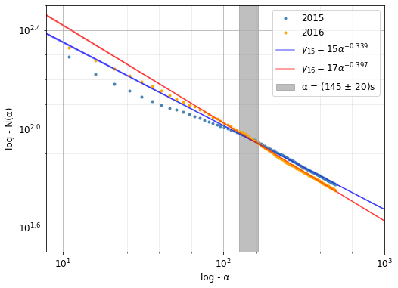
Looking for α and β
06/05/2022
· Variation in centrality correlations α, β = ?
· Minimising common bird difference, weekly difference: α, β << 100s
· Power laws: α = (145 ± 20)s
· Emprical considerations: α = 210s and β = 90s [3][8]
Fig. 8: Change in number of landing times for common birds. At α = 210s and β = 90s.
Fig. 9: log-log plot variation of number of landing in both seasons. α in the range [0,500]s.
Notes:
This was a big part of the project:
Initially, the distributions of landing times with α and β were explored.
·Analysis of the 37 common birds behaviour such as
· Linear trend sraers at around alpha = 145s
· we also looked at the distribution of weekly landing times and attempted to minimize the difference between each week.
This method was a failure as some birds die, are predated…
Also considered other methods, min. std. of weeks… However farmer bahviour varied therefore we can conclude anything from this.
This wasn’t explored further as bird behaviour changes as they age and have less need to feed, or are more prone to infections, disease and being predated during the season.
Even though the initial part of the project was based on finding optimum values for these temporal parameters, we noticed that additional information and time would be needed to confidently define these values. Linear relationships, correlation patterns and overlaps between seasons cannot be used to specify temporal definitions, when factors such as age, predation and seasonal variation within others, are not taken into account.
Empirical considerations: Ecology and biology PhDs have been carried out on this species. After inconclusive results on α and β, communication and footage evidence

Slide 8
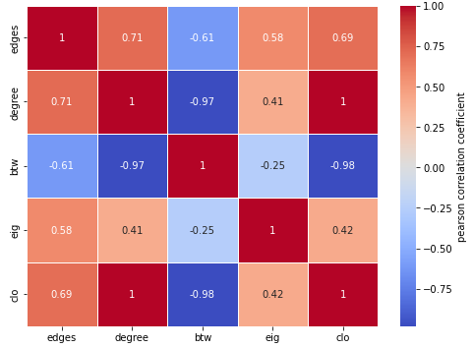
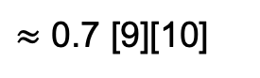
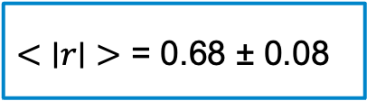
Correlations
06/05/2022
$<\text{∣}r\text{∣}>$ = 0.68 ± 0.08
$≈$ 0.7 [9][10]
Fig. 10: Pearson correlation (r) between parameters: total number edges, the average degree, eigenvector, betweenness and closeness centrality. This plot is extracted by varying α and β in the range of [0, 250]s.
Notes:
We expect the pathway of influence transmitted by nodes that have a high degree and closeness centrality. These can both influence the network easily through direct information propagation or indirectly, as a result of being part of many short paths with other nodes.
Similarly, nodes high in betweenness lie on many Network geodesics. Those with high Eigenvector, are linked to well- connected nodes. All of the nodes high in these measures can influence many other members of the network, either directly or indirectly facilitating or hindering other network connections.
Error in the mean

Slide 9
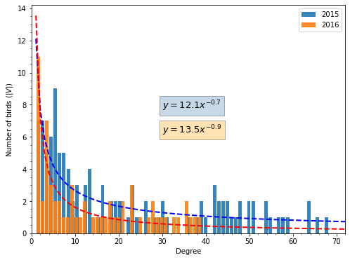
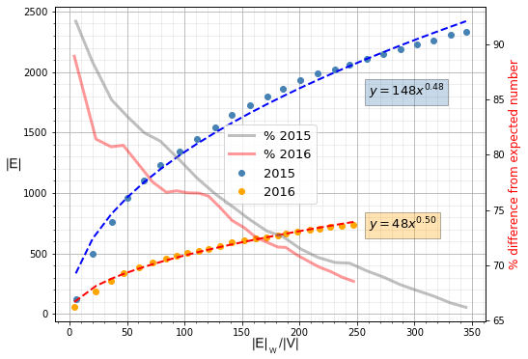
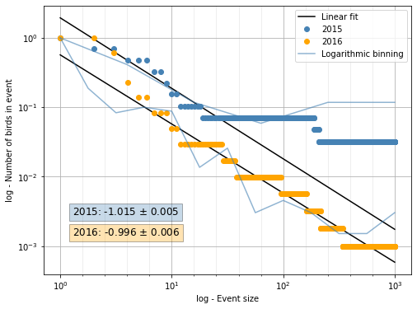
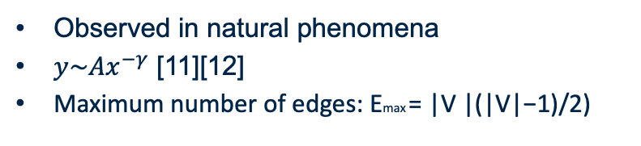
Power laws
06/05/2022
a)
Observed in natural phenomena
${y\sim Ax}^{−γ}$ [11][12]
Maximum number of edges: Emax = |V |(|V|−1)/2)
b)
c)
Fig.11: a) Degree distribution of Network b) Variation of edges with average degree c) Cumulative bird count for a period of absence
Notes:
The distribution of degrees can be seen as the simplest measure that falls under this definition. As seen in Fig. 11, we can fit a simple power-law distribution of the form ∼ Ax−γ to both seasons. The observation of a power-law distribution thus indicates that the placement of edges in the network is, in a sense, far from being random. Nonetheless, these distributions don’t follow power laws precisely. Some studies have also shown this in other networks. Nonetheless, they do tend to have skewed degree distributions with a lot of low-degree nodes and a small number of high-degree hubs.
FAR FROM RANDOM WHICH WOULD BE REPRESENTED BY A BINOMIAL OR POISSON DISTRIBUTION
More predominant unevenness in the power-law description is seen in the data from 2015.
Degree distribution
Variation of edge number with average degree (weighted edges/nodes) against total number of edges
WE TRIED LOGARITHMIC BINNING

Slide 10
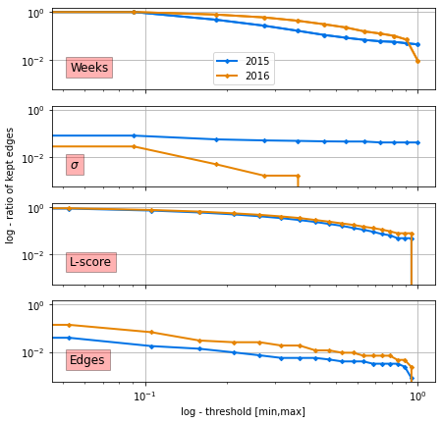
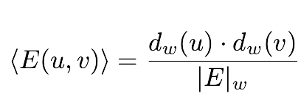
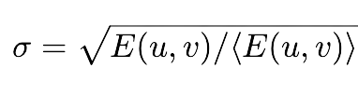
Sparisifcation methods
06/05/2022
Weakest connection
Edge threshold
Logarithmic-score
Expected connections [13]
Weekly repeated connections
(1)
(2)
Fig.12: Ratio of kept edges plotted against a given threshold [min., max.] in a log − log plot for each sparsification method.
Notes:
Logarithmic-score (l-score) ranks friends according to a logarithmic ranking (gives a value from 0 to 1)
(weekly, Nσ, L-score and edge threshold). The edge thresholds is varied from [0, 454] in season 1, and from [0, 298] in season 2. Weeks and Nσ are set to vary from [0,7], while L-score ranges from [0, 1].
Sigma 2016 we loose a lot of connections quickly, as theres not much data and

Slide 11
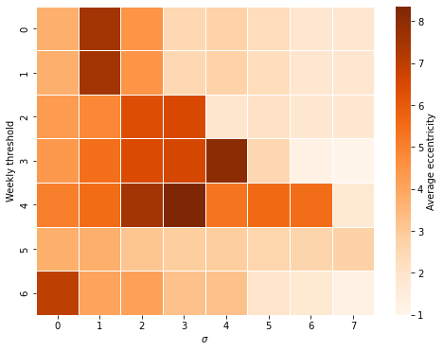
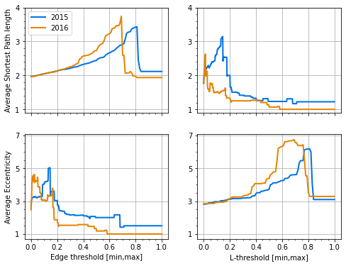
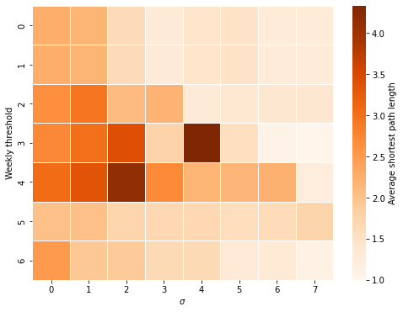
Network shape
06/05/2022
a)
b)
Fig. 13: Network variation with threshold: The average shortest path length and eccentricity are plotted against each sparsification threshold. a) weekly and Nσ b) Edge and L-threshold.
Notes:
Network splits so we expect the dimensions to change

Slide 12
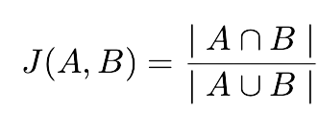
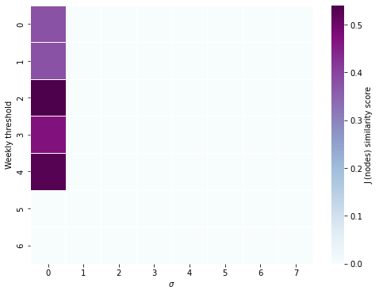
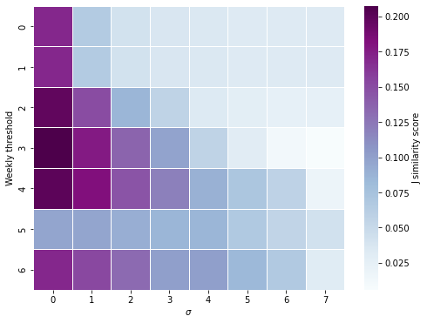
Jaccard similarity (J)
06/05/2022
Set 1
Set 2
Nodes
Edges (weighted and not weighted)
[14] (3)
a)
b)
Fig. 14: Threshold Similarity: Variation in JS (nodes (13) and weighted edge comparison (14) with Weekly repetition (from [0, 6]) and Nσ significance (from [0, 7]) threshold.
Notes:
These plots are for both seasons (2015 and 2016) combined.

Slide 13
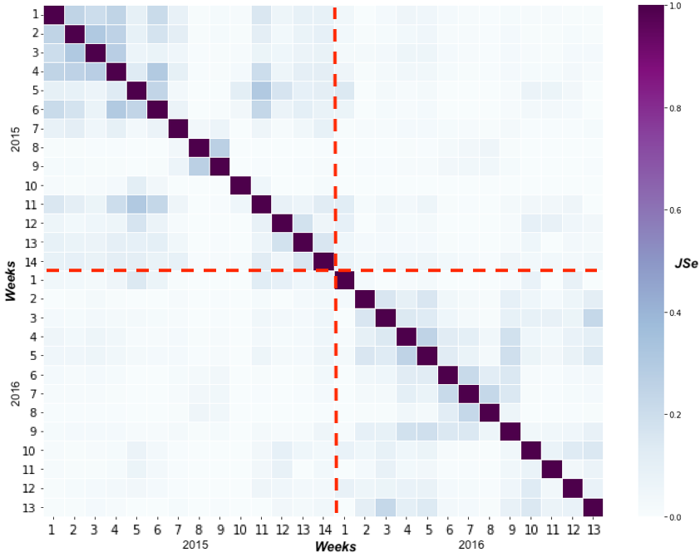
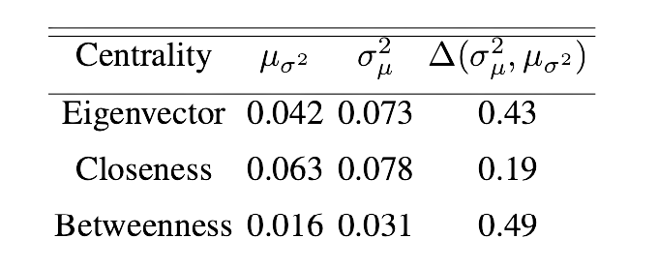
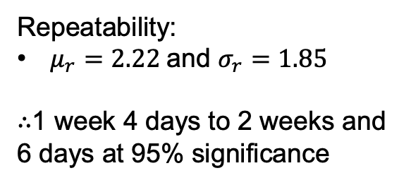
Weekly repeatability
06/05/2022
Repeatability:
$μ_{r}=2.22$and $σ_{r}=1.85$
$∴$1 week 4 days to 2 weeks and
6 days at 95% significance
Table I: The mean of all the variances and the variance of all the means for each centrality, and their relative difference.
Fig. 15: Jaccard edge similarity variation on a week-by-week comparison. The red lines represent where one season ends and the other starts.
Notes:
we plot the variation of the edge similarity (J Se ) on a week-by-week comparison, throughout both sea- sons. As expected, all the diagonals have a value of JSe = 1.
Additionally, the elements closest to the diagonal have the largest JSe values. This could justify our reasoning to think that bird friendships are maintained for more than a week, and vary after a certain number of weeks. To quantify this repetition of the friendships of our Network between weeks, we find the distance of the maximum value in each row, from the diagonal. The mean and standard deviation of this value is calculated to be μr = 2.22 and σr = 1.85, where the subscript r denotes repeatability. Given our sample size, at 1.96 standard errors in the mean, we find μr = 2.22±0.70. We can conclude that the repetition of friendships occurs in the range of 1 week and 4 days, to 2 weeks and 6 days, at a 95% significance level.
All these measures are significant at a significance level of above 10%, hinting at the immutability of bird social traits.

Slide 14
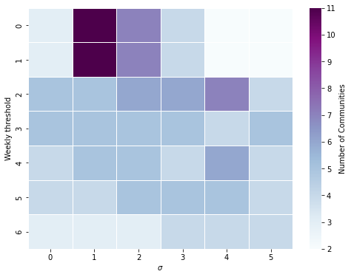
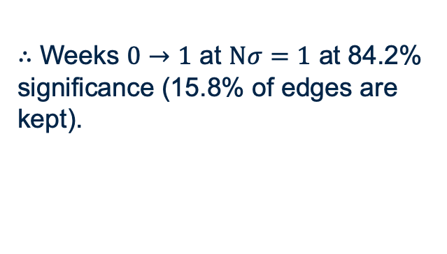
Flock size: Community detection
06/05/2022
$∴$ Weeks $0→1$ at $Nσ=1$ at 84.2% significance (15.8% of edges are kept).
Fig. 16: Variation in number of communities with weekly repetition [0,6] and the number of Standard deviations (Nσ) [0,5] thresholds.
Notes:
We attempt to analyse the variation of the number of flocks (communities) as we vary different sparsification thresholds, such as; L-score, Weekly and Nσ threshold. The resulting heat maps for each of these are plotted.
Increasing the L-score threshold forms more sub-Networks and communities, as the Network forms more branching structures at its higher values.
We also plotted the other threshold but showed a very uniform distribution
If the number of Sparrow communities on the island was known, such as the usual number of friends each bird feeds with, we could find threshold parameters that optimise the number of flocks. From Fig. 21c, if we optimised for the largest number of sparrow communities on the island, we would expect sparrow friendships to vary on a weekly/two- week basis. These connections have a threshold of Nσ = 1 from the expected, representing a significance level of 84.2%, as only the top 15.8% of the edges of the original network have been kept.

Slide 15
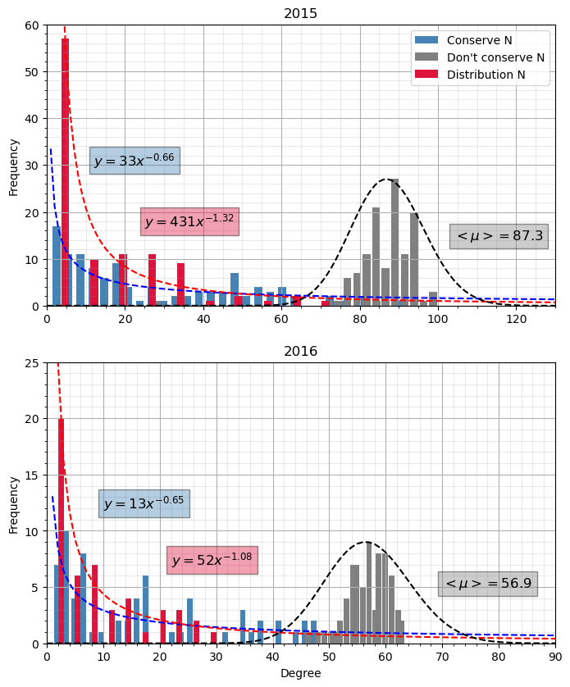
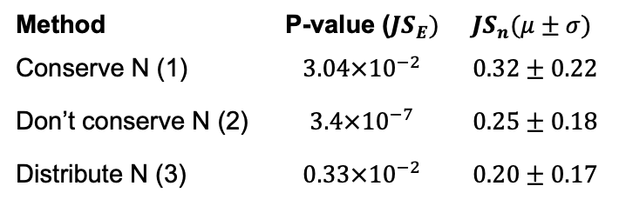
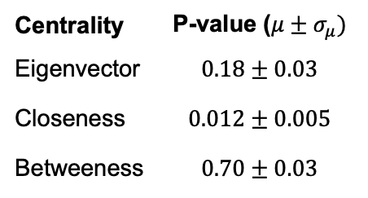
Simulated Networks
06/05/2022
1) Method 1 - Conserve Bird Landing Number
2) Method 2 - Don’t Conserve Bird Landing Number
3) Method 3 - Distribute Bird Landing Numbers
Method | P-value ($JS_{E})$ | $$JS_{n}(μ±σ)$$
Conserve N (1) | $$3.04×{10}^{−2}$$ | $$0.32±0.22$$
Don’t conserve N (2) | $$3.4×{10}^{−7}$$ | $$0.25±0.18$$
Distribute N (3) | $$0.33×{10}^{−2}$$ | $$0.20±0.17$$
Table II: Jaccard similarity between the randomised method.
Centrality | P-value ($μ±σ_{μ})$
Eigenvector | $$0.18±0.03$$
Closeness | $$0.012±0.005$$
Betweeness | $$0.70±0.03$$
Table III: Centrality p-value’s extracted from 100 randomised trials of method 3.
Fig. 17: Degree distribution for all three random method, averaged over 5 simulations.
Notes:
The first random method uses the times from the Sparrow feeder data, scrambled and distributed non-uniformly to each node, according to their landing frequency.
2) The second method is similar to method 1. However, in this case, each bird is allocated the same number of landing times as every other bird.
3) The third and last random method doesn’t use any of the individual RFID readings but instead uses the diurnal and seasonal distribution of bird landings (these are fits to Fig. 4 and 3).
ode distribution varies with degree. As we’d expect, the most random Network (Method 2 - dC.N.), follows an approximately Poisson distribution with average degree ⟨μ⟩ and width ⟨μ⟩1/2. But due to our small network size, we can see its not completely poissonic and more a binomial
On the other hand, method 1 (C.N), follows a more uniform, slower decreasing power law, relative to method 3 (D.N) and our Network (see Fig. 11). Nonetheless, this still indicates that some nodes of different sizes coexist in the Network.
Similarity comparison between our data and all 3 random methods; conserve landing number (C.N.), don’t conserve landing number (dC.N.) and using the distribution of landing number (D.N), over 100 runs.
JS edges average of all networks: WEEKLY MEAN REPEATBILITY OF FRIENDSHIP LINKS:
the mean of the weekly comparisons for C.N. lies 1.87σ below the mean of the data. Similarly, dC.N and D.N. lie 4.97σ and 2.72σ away for season 1. These represent a significance level of 3.04%, 3.4x10−5% and 0.33%, for C.N., dC.N and D.N.
Significant < 5%.
PVALUES
Finally, to compare our last random method (D.N.) against our data, we perform a χ2− squared test for each bird’s centrality (Ci with i = E,B,C) among the 100 trials. The distribution is plotted in Fig. 23. We find for both CE and CC , the mean p-values with associated errors of the mean are pE = 0.18 ± 0.03 and pC = 0.012 ± 0.005. Meanwhile, CB has pB = 0.70 ± 0.03. This means > 99% of the time, our randomised method will produce significantly different bird closeness centrality measures for all birds. For eigenvector centrality, we still find an abundance of low p-values, how- ever, not significant enough to be able to conclude they are significantly different. Betweenness shows overly similar, yet very spread results.
$∴$ $>99\%$ significantly different results

Slide 16
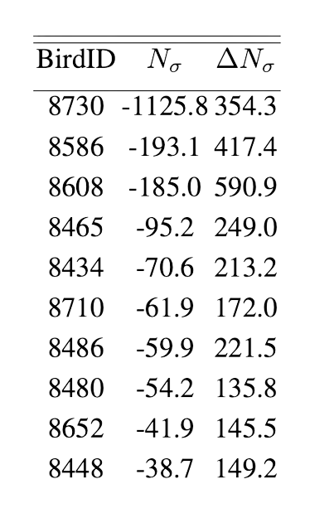
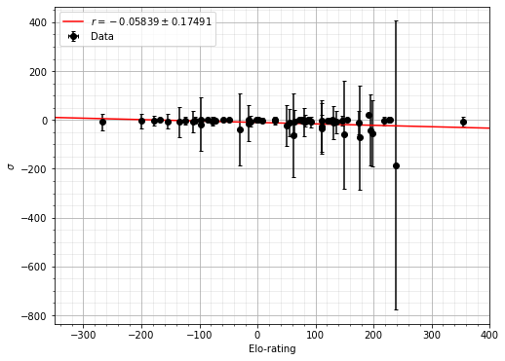
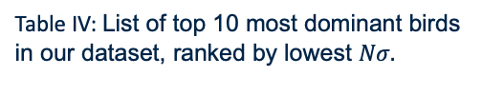
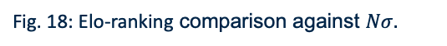
Dominance
06/05/2022
Our results:
Comparison:
Gender [3]
Elo-rankings [8]
Table IV: List of top 10 most dominant birds in our dataset, ranked by lowest $Nσ.$
Fig. 18: Elo-ranking comparison against $Nσ.$
Notes:
To test the relationship between sex and dominance, we compare our dominance rank to a sex spreadsheet from [5]. This spreadsheet has a limited number of Bird IDs, with only 80 birds for which roughly all of them have a Nσ = 0 in our Network.
We don’t have data for the top 10 most dominant birds in Table V. This may be because usually, ornithologists wait until juveniles and females grow to record their sex, as it’s hard to identify their sex visually when they are very young. These sometimes die before they moult into their adult plumages.
Nonetheless, we believe no definitive conclusions can be extracted from the dominance list, as it is very unlikely that either extreme in life span dominates the feeder. Instead, we propose studying this further, with more conclusive data.
Plot of elo- and Nσ- rating. The errorbars represent the standard error in the mean (Nσ).

Slide 17

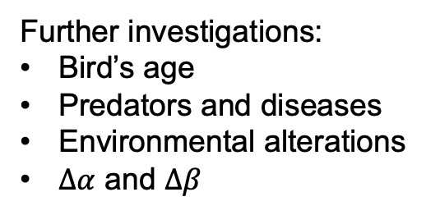
Conclusions
06/05/2022
and what’s to come
Further investigations:
Bird’s age
Predators and diseases
Environmental alterations
$Δα$ and $Δβ$
Fig. 19: A picture of a Sparrow [3].
Notes:
In this investigation, we have analysed and visualised Networks of time series RFID data, from a Sparrow feeder in Lundy Island, a small island off the North Devon coast of the UK. We have done this by introducing temporal parameters to identify sparrows’ landings, and how they form connections; by synchronising activities such as foraging, where they can be considered to be in the same social grouping. We have analysed centrality measures, network dimensions and communities within the sparrow Network. Additionally, we have created sparsification methods to identify the most im- portant connections in the Network. By; removing the weakest edge from each node, filtering edges under a certain weight, edges below a certain logarithmic rank (l-score), filtering above certain standard deviations above the expected number of connections and removing friendships that don’t appear on a weekly basis. Additionally, the expected connections method allows us to extract a list of the most dominant birds at the feeder, by looking at those that differ the most. We compare this method to Elo-ratings and have found no significant correlation.
We have also implemented methods to find the similarity between Networks. By finding the Jaccard similarity of node friendships, or the total edges, and by looking at the centrality measures correlation between the same bird in each Network.
Observing the maximum similarity between weeks; we have compared the edges present in a week with every other week in our data. We calculate the distance the maximum similarity from that week is away from its direct comparison (i.e diagonal elements in a heat map). Doing this, we find mean weekly repeatability of 2 weeks and 2 days with a margin of error of ±4 days, at a 95% significance level. We have found that optimising for the maximum number of communities corroborates these results, a significance level of 1σ above the expected number of connections.
Nonetheless, this investigation is far from complete. In addition to the factors we have investigated, more data should be analysed, such as birds’ age, predators, diseases and the en- vironment that can contribute to any alteration to their lifespan and hence feeding patterns. Additionally, bird behaviour in the feeder; such as the jumping in and out, can be dependent on other factors. For example, a bird may jump more; if there are dominant birds present in the feeder, or if they are more juvenile. Further investigations could take this into account, by analysing the network with variable temporal parameters.
Sparrow interaction is way more complex than what we initially thought, looking at some simple patterns may not be the way to describe behaviour that has evolved over so many centuries

Slide 18
Aknowledgements
06/05/2022
I would like to thank Jammie Dunning, Alex Chan [3], Tim Evans [13] and Dariusz Duszynski for our interesting conversations and contributions in our meetings.
We will visit the feeder soon:)
Notes:
They have provided significant valuable analytical and ecological insight into sparrow behaviour and Networks, a completely new topic for us at the start of this project.

Slide 19
References
06/05/2022
[1] T. Evans, “Network notes,” complexity and Networks Course, Level 3 course. (PHYS96008) Physics Department, Imperial College London.
[2] G. Perrone, J. Unpingco, and H. Lu, “Network visualizations with pyvis and visjs,” CoRR, vol. abs/2006.04951, 2020. [Online]. Available: https://arxiv.org/abs/2006.04951.
[3] J. Dunning, 01.2022 - 04.2022, Email and Microsoft teams meetings [Online].
[4] C. G. Casinello, J., “Spatial association in a highly inbred ungulate population: evidence of fine-scale kin recognition.” Ethology, vol. 114, p. 124–132, 2008.
[5] C. L and R. T. J, “Activity synchrony and social cohesion: a fission-fusion model,” p. B.2672213–2218, 2000.
[6] M. E. J. Newman, “Fast algorithm for detecting community structure in networks,” Phys. Rev. E, vol. 69, p. 066133, Jun 2004. [Online]. Available: https://link.aps.org/doi/10.1103/PhysRevE.69.066133
[7] S. Arifuzzaman, “CENTRALITY MEASURES”. CS 6604: Data Mining Large Networks and Time-series Fall 2013.
[8] A. Sánchez-Tójar, “The evolution of social dominance in house sparrows,” Ph.D. dissertation, Universitat Konstanz, Konstanz, 2018.
[9] L. C. C. E. Valente TW, Coronges K, “How correlated are network centrality measures?” Connect (Tor), vol. 28(1), pp. 16–26, Jan 1 2008.

Slide 20
06/05/2022
[10] F. Grando, D. Noble, and L. C. Lamb, “An analysis of centrality measures for complex and social networks,” in 2016 IEEE Global Communications Conference (GLOBECOM). EEE, dec 2016. [Online]. Available: https://doi.org/10.1109%2Fglocom.2016.7841580.
[11] A. D. Broido and A. Clauset, “Scale-free networks are rare,” Nature Communications, vol. 10, no. 1, mar 2019. [Online]. Available: https://doi.org/10.1038%2Fs41467-019-08746-5.
[12] O. Peters, C. Hertlein, and K. Christensen, “A complexity view of
rainfall,” Physical review letters, vol. 88, p. 018701, 02 2002.
[13] T. Evans, 01.2022 - 04.2022, Weekly in-person Supervisor meetings.
[14] F. Karabiber, “Jaccard similarity,” ph.D. in Computer Engineering, Data Scientist. Associate Professor of Computer Engineering. [Online]. Available: https://www.learndatasci.com/glossary/jaccard-similarity/

Slide 21
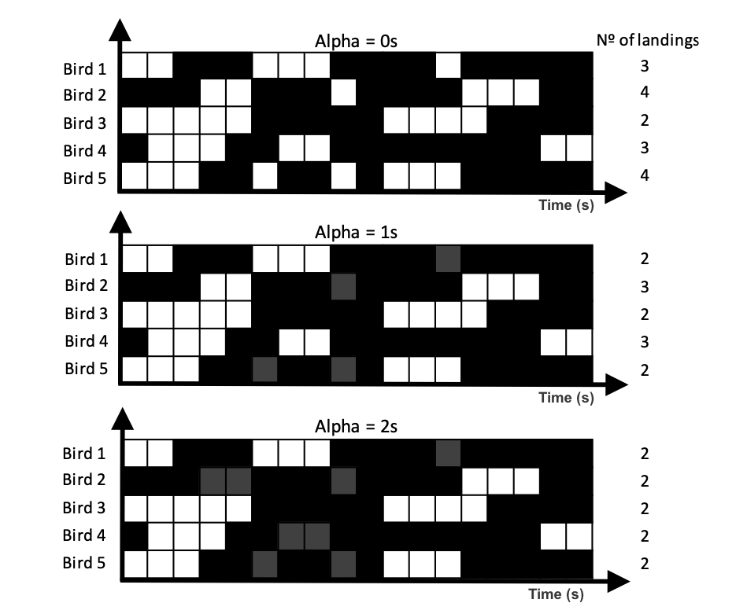
The making of a network
Appendix
06/05/2022
Definition 1: Alpha (α) is the minimum time of absence of a sparrow for the next time it appears at the feeder (a new RFID reading) to be considered a new landing.
Fig. 5: Landing time variation with alpha: An example database of 5 birds over 18s
Notes:
In its simplest form, a network is a collection of points, or nodes (vertices), joined with lines, or edges [13]. In our analysis, each node represents a bird. An edge is a social connection between two birds.
To create these networks we must first parametrize and clean up the data.
We first do this by introducing alpha:
This is done to remove artefacts of data, such as juping behvaiour of birds and to create a continuous presence in the feeder, when the RFID hardware might not be detecting it.
Variation in the number of landing times with alpha is seen in this plots.

Slide 22
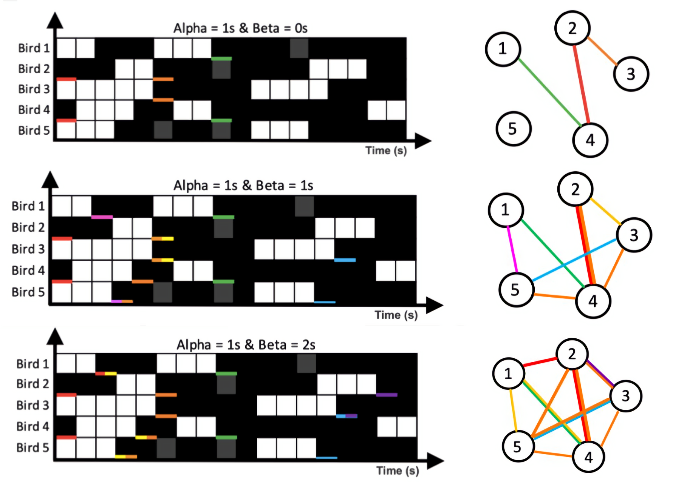
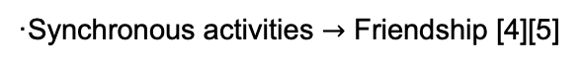
06/05/2022
Definition 2: Beta (β) is the maximum landing time separation between two different sparrows to be considered a connection/edge in our network.
·Synchronous activities $→$ Friendship [4][5]
Fig. 6: Connection variation with beta: An example database of 5 birds over 18s. The time when a connection between two birds is formed, it’s underlined with the same colour.
Notes:
Beta is the second paraemeter used to

Slide 23
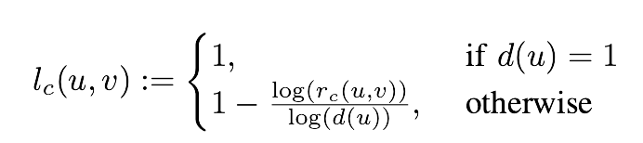
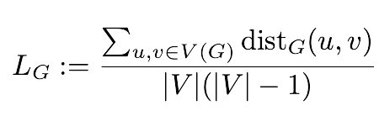
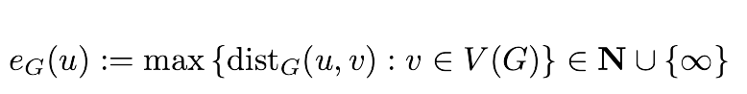
Equations
06/05/2022
L-score:
(4)
(5)
Average shortest path:
Eccentricity:
(6)

Slide 24
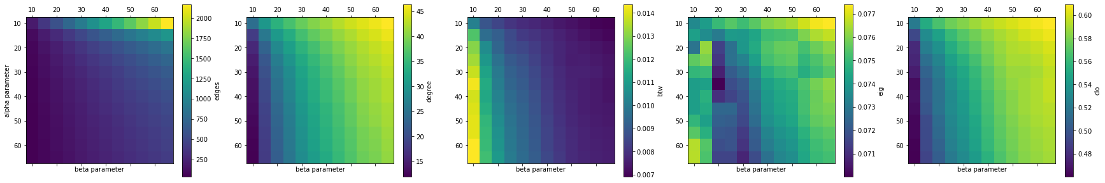
Variation in centrality correlations
06/05/2022
Fig. 20: Centrality variation with α and β: Total number of edges |E| (1) and average centrality variation (Degree (2), Betweeness (3), Eigenvector (4) and Closeness (5)) plotted as a function of α and β in the initial range of [0, 60]. This becomes more uniform at larger extremes.

Slide 25
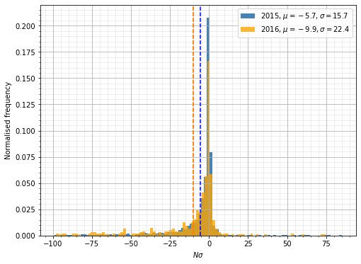
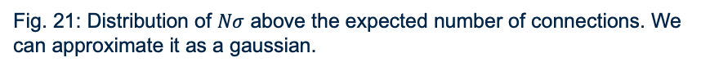

Distribution of $Nσ$ above expected
06/05/2022
Fig. 21: Distribution of $Nσ$ above the expected number of connections. We can approximate it as a gaussian.

Slide 26


P-values
06/05/2022
Fig. 22: Distribution of $p−$values for each centrality measure, compared over 100 simulated trials of method 3 (distribution of N).

Slide 27

Correlations
06/05/2022
Fig. 23: Average Pearson correlation of centrality measures for weekly and $Nσ$ thresholds.

